Slide 1
COD Ch. 3
Instructions: Language of the Machine

Slide 2
Instructions: Overview
Language of the machine
More primitive than higher level languages, e.g.,binary instructions, no sophisticated control flow such as while or for loops
Very restrictive
  e.g., MIPS arithmetic instructions
We’ll be working with the MIPS instruction set architecture
  inspired most architectures developed since the 80's
  used by NEC, Nintendo, Silicon Graphics, Sony
  the name is just not related to millions of instructions per second !
  it stands for microcomputer without interlocked pipeline stages !
Design goals: maximize performance and minimize cost and reduce design time

Slide 3
MIPS Arithmetic
All MIPS arithmetic instructions have 3 operands
Operand order is fixed (e.g., destination first)
Example:
C code: A = B + C
MIPS code: add $s0, $s1, $s2
compiler’s job to associate
variables with registers

Slide 4
MIPS Arithmetic
Design Principle 1: simplicity favors regularity.
Translation: Regular instructions make for simple hardware!
Simpler hardware reduces design time and manufacturing cost.
Of course this complicates some things...
C code: A = B + C + D;
E = F - A;
MIPS code add $t0, $s1, $s2
(arithmetic): add $s0, $t0, $s3
sub $s4, $s5, $s0
Performance penalty: high-level code translates to denser machine code.
Allowing variable number
of operands would
simplify the assembly
code but complicate the
hardware.

Slide 5
MIPS Arithmetic
Operands must be in registers – only 32 registers provided (which require 5 bits to select one register). Reason for small number of registers:
Design Principle 2: smaller is faster. Why?
  Electronic signals have to travel further on a physically larger chip increasing clock cycle time.
  Smaller is also cheaper!

Slide 6
Registers vs. Memory
Arithmetic instructions operands must be in registers
  MIPS has 32 registers
Compiler associates variables with registers
What about programs with lots of variables (arrays, etc.)? Use memory, load/store operations to transfer data from memory to register – if not enough registers spill registers to memory
MIPS is a load/store architecture
Control
Input
Memory
Datapath
Output
Processor
I/O

Slide 7
Memory Organization
Viewed as a large single-dimension array with access by address
A memory address is an index into the memory array
Byte addressing means that the index points to a byte of memory, and that the unit of memory accessed by a load/store is a byte
0
8 bits of data
1
8 bits of data
2
8 bits of data
3
8 bits of data
4
8 bits of data
5
8 bits of data
6
8 bits of data
...

Slide 8
Memory Organization
Bytes are load/store units, but most data items use larger words
For MIPS, a word is 32 bits or 4 bytes.
2³² bytes with byte addresses from 0 to 2³²-1
2³⁰ words with byte addresses 0, 4, 8, ... 2³²-4
  i.e., words are aligned
  what are the least 2 significant bits of a word address?
0
32 bits of data
4
32 bits of data
Registers correspondingly hold 32 bits of data
8
32 bits of data
12
32 bits of data
...

Slide 9
Load/Store Instructions
Load and store instructions
Example:
C code: A[8] = h + A[8];
MIPS code (load): lw $t0, 32($s3)
(arithmetic): add $t0, $s2, $t0
(store): sw $t0, 32($s3)
Load word has destination first, store has destination last
Remember MIPS arithmetic operands are registers, not memory locations
  therefore, words must first be moved from memory to registers using loads before they can be operated on; then result can be stored back to memory
value
offset
address

Slide 10
So far we’ve learned:
MIPS
  loading words but addressing bytes
  arithmetic on registers only
Instruction Meaning
add $s1, $s2, $s3 $s1 = $s2 + $s3
sub $s1, $s2, $s3 $s1 = $s2 – $s3
lw $s1, 100($s2) $s1 = Memory[$s2+100]
sw $s1, 100($s2) Memory[$s2+100]= $s1

Slide 11
Machine Language
Instructions, like registers and words of data, are also 32 bits long
  Example: add $t0, $s1, $s2
  registers are numbered, e.g., $t0 is 8, $s1 is 17, $s2 is 18
Instruction Format R-type (“R” for aRithmetic):
000000
10001
10010
01000
00000
100000
6 bits 5 bits 5 bits 5 bits 5 bits 6 bits
op rs rt rd shamt funct
opcode –
operation
first
register
source
operand
second
register
source
operand
register
destin-
ation
operand
shift
amount
function field -
selects variant
of operation

Slide 12
Machine Language
Consider the load-word and store-word instructions,
  what would the regularity principle have us do?
    we would have only 5 or 6 bits to determine the offset from a base register - too little…
Design Principle 3: Good design demands a compromise
Introduce a new type of instruction format
  I-type (“I” for Immediate) for data transfer instructions
  Example: lw $t0, 1002($s2)
  100011 10010 01000 0000001111101010
  op rs rt 16 bit offset
6 bits 5 bits 5 bits 16 bits

Slide 13
Stored Program Concept
Instructions are bit sequences, just like data
Programs are stored in memory
  to be read or written just like data
Fetch & Execute Cycle
  instructions are fetched and put into a special register
  bits in the register control the subsequent actions (= execution)
  fetch the next instruction and repeat
memory for data, programs,
compilers, editors, etc.
Processor
Memory

Slide 14
SPIM – the MIPS simulator
SPIM (MIPS spelt backwards!) is a MIPS simulator that
  reads MIPS assembly language files and translates to machine language
  executes the machine language instructions
  shows contents of registers and memory
  works as a debugger (supports break-points and single-stepping)
  provides basic OS-like services, like simple I/O
SPIM is freely available on-line
An important part of our course is to actually write MIPS assembly code and run using SPIM – the only way to learn assembly (or any programming language) is to write lots and lots of code!!!
Refer to our material, including slides, on SPIM

Slide 15
Memory Organization:
Big/Little Endian Byte Order
Bytes in a word can be numbered in two ways:
  byte 0 at the leftmost (most significant) to byte 3 at the rightmost (least significant), called big-endian
  byte 3 at the leftmost (most significant) to byte 0 at the rightmost (least significant), called little-endian
0 1 2 3
3 2 1 0
Big-endian
Memory
Little-endian
Memory
Bit 31
Bit 0
Bit 31
Bit 0
Byte 0
Byte 1
Byte 2
Byte 3
Word 0
Byte 3
Byte 2
Byte 1
Byte 0
Word 0
Byte 4
Byte 5
Byte 6
Byte 7
Word 1
Byte 7
Byte 6
Byte 5
Byte 4
Word 1

Slide 16
Memory Organization:
Big/Little Endian Byte Order
SPIM’s memory storage depends on that of the underlying machine
  Intel 80x86 processors are little-endian
  because SPIM always shows words from left to right a “mental adjustment” has to be made for little-endian memory as in Intel PCs in our labs: start at right of first word go left, start at right of next word go left, …!
Word placement in memory (from .data area of code) or word access (lw, sw) is the same in big or little endian
Byte placement and byte access (lb, lbu, sb) depend on big or little endian because of the different numbering of bytes within a word
Character placement in memory (from .data area of code) depend on big or little endian because it is equivalent to byte placement after ASCII encoding
Run storeWords.asm from SPIM examples!!

Slide 17
Control: Conditional Branch
Decision making instructions
  alter the control flow,
    i.e., change the next instruction to be executed
MIPS conditional branch instructions:
bne $t0, $t1, Label
beq $t0, $t1, Label
Example: if (i==j) h = i + j;
bne $s0, $s1, Label
add $s3, $s0, $s1
Label: ....
I-type instructions
beq $t0, $t1, Label
(= addr.100)
000100 01000 01001 0000000000011001
word-relative addressing:
25 words = 100 bytes;
also PC-relative (more…)

Slide 18
Addresses in Branch
Instructions:
  bne $t4,$t5,Label Next instruction is at Label if $t4 != $t5
  beq $t4,$t5,Label Next instruction is at Label if $t4 = $t5
Format:
16 bits is too small a reach in a 2³² address space
Solution: specify a register (as for lw and sw) and add it to offset
  use PC (= program counter), called PC-relative addressing, based on
  principle of locality: most branches are to instructions near current instruction (e.g., loops and if statements)
I
op rs rt 16 bit offset

Slide 19
Addresses in Branch
Further extend reach of branch by observing all MIPS instructions are a word (= 4 bytes), therefore word-relative addressing:
MIPS branch destination address = (PC + 4) + (4 * offset)
  so offset = (branch destination address – PC – 4)/4
  but SPIM does offset = (branch destination address – PC)/4
Because hardware typically increments PC early
in execute cycle to point to next instruction

Slide 20
Control: Unconditional Branch (Jump)
MIPS unconditional branch instructions:
j Label
Example:
if (i!=j) beq $s4, $s5, Lab1
h=i+j; add $s3, $s4, $s5
else j Lab2
h=i-j; Lab1: sub $s3, $s4, $s5
Lab2: ...
J-type (“J” for Jump) instruction format
  Example: j Label # addr. Label = 100
word-relative
addressing:
25 words = 100 bytes
000010
00000000000000000000011001
6 bits 26 bits
op
26 bit number

Slide 21
Addresses in Jump
Word-relative addressing also for jump instructions
MIPS jump j instruction replaces lower 28 bits of the PC with A00 where A is the 26 bit address; it never changes upper 4 bits
  Example: if PC = 1011X (where X = 28 bits), it is replaced with 1011A00
  there are 16(=2⁴) partitions of the 2³² size address space, each partition of size 256 MB (=2²⁸), such that, in each partition the upper 4 bits of the address is same.
  if a program crosses an address partition, then a j that reaches a different partition has to be replaced by jr with a full 32-bit address first loaded into the jump register
  therefore, OS should always try to load a program inside a single partition
J
op 26 bit address

Slide 22
Constants
Small constants are used quite frequently (50% of operands)
e.g., A = A + 5;
B = B + 1;
C = C - 18;
Solutions? Will these work?
  create hard-wired registers (like $zero) for constants like 1
  put program constants in memory and load them as required
MIPS Instructions:
addi $29, $29, 4
slti $8, $18, 10
andi $29, $29, 6
ori $29, $29, 4
How to make this work?

Slide 23
Immediate Operands
Make operand part of instruction itself!
Design Principle 4: Make the common case fast
Example: addi $sp, $sp, 4 # $sp = $sp + 4
001000
11101
11101
0000000000000100
6 bits 5 bits 5 bits 16 bits
op
rs
rt
16 bit number

Slide 24
How about larger constants?
First we need to load a 32 bit constant into a register
Must use two instructions for this: first new load upper immediate instruction for upper 16 bits
lui $t0, 1010101010101010
Then get lower 16 bits in place:
ori $t0, $t0, 1010101010101010
Now the constant is in place, use register-register arithmetic
filled with zeros
1010101010101010
0000000000000000
1010101010101010
0000000000000000
0000000000000000
1010101010101010
ori
1010101010101010
1010101010101010

Slide 25
So far
Instruction Format Meaning
add $s1,$s2,$s3 R $s1 = $s2 + $s3
sub $s1,$s2,$s3 R $s1 = $s2 – $s3
lw $s1,100($s2) I $s1 = Memory[$s2+100]
sw $s1,100($s2) I Memory[$s2+100] = $s1
bne $s4,$s5,Lab1 I Next instr. is at Lab1 if $s4 != $s5
beq $s4,$s5,Lab2 I Next instr. is at Lab2 if $s4 = $s5
j Lab3 J Next instr. is at Lab3
Formats:
R
I
J
op rs rt rd shamt funct
op rs rt 16 bit address
op 26 bit address

Slide 26
Control Flow
We have: beq, bne. What about branch-if-less-than?
New instruction:
if $s1 < $s2 then
$t0 = 1
slt $t0, $s1, $s2 else
$t0 = 0
Can use this instruction to build blt $s1, $s2, Label
  how? We generate more than one instruction – pseudo-instruction
  can now build general control structures
The assembler needs a register to manufacture instructions from pseudo-instructions
There is a convention (not mandatory) for use of registers

Slide 27
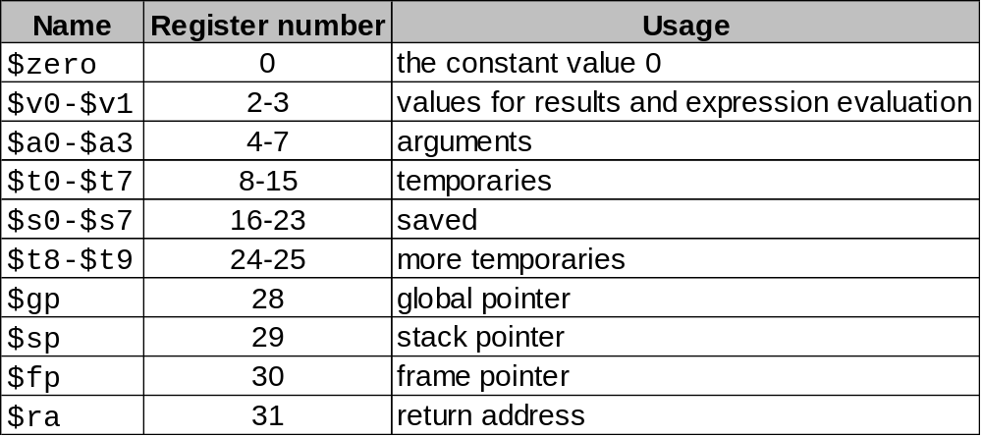
Policy-of-Use Convention for Registers
Register 1, called $at, is reserved for the assembler; registers 26-27,
called $k0 and $k1 are reserved for the operating system.

Slide 28
Assembly Language vs. Machine Language
Assembly provides convenient symbolic representation
  much easier than writing down numbers
  regular rules: e.g., destination first
Machine language is the underlying reality
  e.g., destination is no longer first
Assembly can provide pseudo-instructions
  e.g., move $t0, $t1 exists only in assembly
  would be implemented using add $t0, $t1, $zero
When considering performance you should count actual number of machine instructions that will execute

Slide 29
Procedures
Example C code:
// procedure adds 10 to input parameter
int main()
{ int i, j;
i = 5;
j = add10(i);
i = j;
return 0;}
int add10(int i)
{ return (i + 10);}

Slide 30
Procedures
Translated MIPS assembly
Note more efficient use of registers possible!
.text
.globl main
main:
addi $s0, $0, 5
add $a0, $s0, $0
jal add10
add $s1, $v0, $0
add $s0, $s1, $0
li $v0, 10
syscall
save register
in stack, see
figure below
add10:
addi $sp, $sp, -4
sw $s0, 0($sp)
addi $s0, $a0, 10
add $v0, $s0, $0
lw $s0, 0($sp)
addi $sp, $sp, 4
jr $ra
argument
to callee
result
to caller
control returns here
jump and link
restore
values
return
system code
& call to
exit
MEMORY
High address
$sp
Content of $s0
Run this code with PCSpim: procCallsProg1.asm
Low address

Slide 31
MIPS: Software Conventions for Registers
0 zero constant 0
1 at reserved for assembler
2 v0 results from callee
3 v1 returned to caller
4 a0 arguments to callee
5 a1 from caller: caller saves
6 a2
7 a3
8 t0 temporary: caller saves
. . . (callee can clobber)
15 t7
16 s0 callee saves
. . . (caller can clobber)
23 s7
24 t8 temporary (cont’d)
25 t9
26 k0 reserved for OS kernel
27 k1
28 gp pointer to global area
29 sp stack pointer
30 fp frame pointer
ra return Address (HW):
caller saves

Slide 32
Procedures (recursive)
Example C code – recursive factorial subroutine:
int main()
{ int i;
i = 4;
j = fact(i);
return 0;}
int fact(int n)
{ if (n < 1) return (1);
else return ( n*fact(n-1) );}

Slide 33
Procedures (recursive)
Translated MIPS assembly:
.text
.globl main
main:
addi $a0, $0, 4
jal fact
nop
move $a0, $v0
li $v0, 1
syscall
li $v0, 10
syscall
fact:
addi $sp, $sp, -8
sw $ra, 4($sp)
sw $a0, 0($sp)
slti $t0, $a0, 1
beq $t0, $0, L1
nop
addi $v0, $0, 1
addi $sp, $sp, 8
jr $ra
L1:
addi $a0, $a0, -1
jal fact
nop
lw $a0, 0($sp)
lw $ra, 4($sp)
addi $sp, $sp, 8
mul $v0, $a0, $v0
jr $ra
branch to
L1 if n>=1
control
returns
from fact
return 1
if n < 1
print value
returned by
fact
if n>=1 call
fact recursively
with argument
n-1
exit
restore return
address, argument,
and stack pointer
save return
address and
argument in
stack
return
n*fact(n-1)
Run this code with PCSpim: factorialRecursive.asm
return control

Slide 34
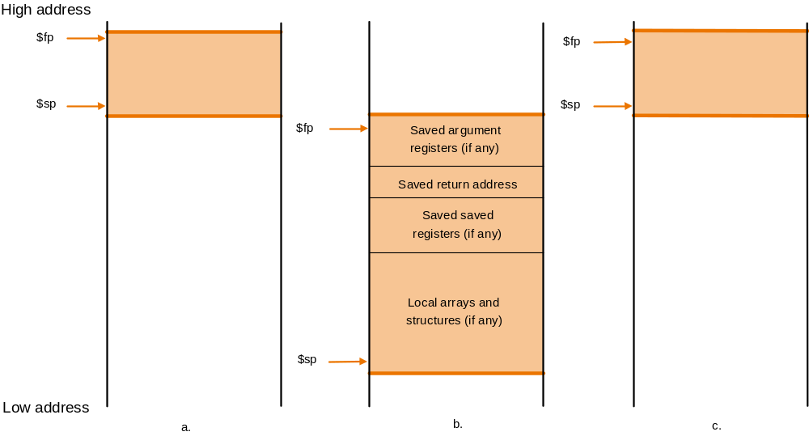
Using a Frame Pointer
Variables that are local to a procedure but do not fit into registers (e.g., local arrays, struc-
tures, etc.) are also stored in the stack. This area of the stack is the frame. The frame pointer
$fp points to the top of the frame and the stack pointer to the bottom. The frame pointer does
not change during procedure execution, unlike the stack pointer, so it is a stable base
register from which to compute offsets to local variables.
Use of the frame pointer is optional. If there are no local variables to store in the stack it is
not efficient to use a frame pointer.

Slide 35
Using a Frame Pointer
Example: procCallsProg1Modified.asm
This program shows code where it may be better to use $fp
  Because the stack size is changing, the offset of variables stored in the stack w.r.t. the stack pointer $sp changes as well. However, the offset w.r.t. $fp would remain constant.
  Why would this be better?
  The compiler, when generating assembly, typically maintains a table of program variables and their locations. If these locations are offsets w.r.t $sp, then every entry must be updated every time the stack size changes!
Exercise:
Modify procCallsProg1Modified.asm to use a frame pointer
  Observe that SPIM names register 30 as s8 rather than fp. Of course, you can use it as fp, but make sure to initialize it with the same value as sp, i.e., 7fffeffc.

Slide 36
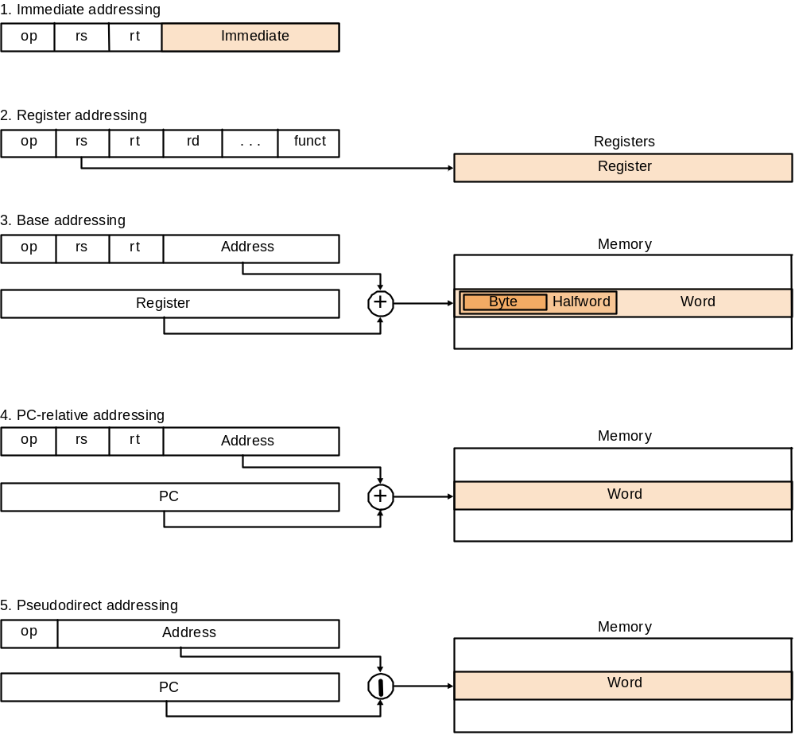
MIPS Addressing Modes

Slide 37
Overview of MIPS
Simple instructions – all 32 bits wide
Very structured – no unnecessary baggage
Only three instruction formats
Rely on compiler to achieve performance
  what are the compiler's goals?
Help compiler where we can
op rs rt rd shamt funct
R
I
op rs rt 16 bit address
op 26 bit address
J

Slide 38
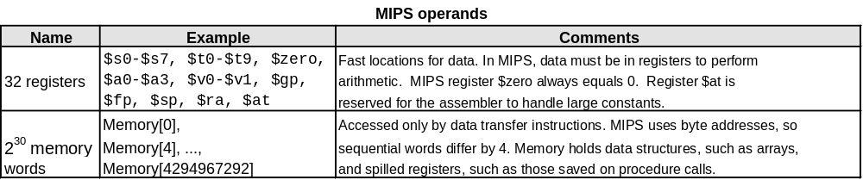
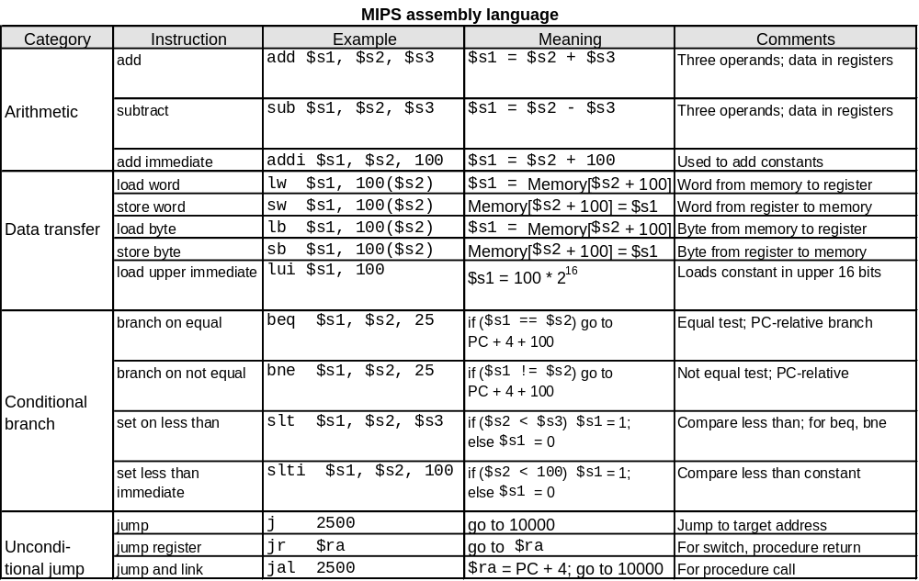
Summarize MIPS:

Slide 39
Alternative Architectures
Design alternative:
  provide more powerful operations
  goal is to reduce number of instructions executed
  danger is a slower cycle time and/or a higher CPI
Sometimes referred to as R(educed)ISC vs. C(omplex)ISC
  virtually all new instruction sets since 1982 have been RISC
We’ll look at PowerPC and 80x86

Slide 40
PowerPC Special Instructions
Indexed addressing
  Example: lw $t1,$a0+$s3 #$t1=Memory[$a0+$s3]
  what do we have to do in MIPS? add $t0, $a0, $s3
  lw $t1, 0($t0)
Update addressing
  update a register as part of load (for marching through arrays)
  Example: lwu $t0,4($s3) #$t0=Memory[$s3+4];$s3=$s3+4
  what do we have to do in MIPS? lw $t0, 4($s3)
  addi $s3, $s3, 4
Others:
  load multiple words/store multiple words
  a special counter register to improve loop performance:
  bc Loop, ctrl != 0 # decrement counter, if not 0 goto loop
  MIPS: addi $t0, $t0, -1
  bne $t0, $zero, Loop

Slide 41
A dominant architecture:
80x86
1978: The Intel 8086 is announced (16 bit architecture)
1980: The 8087 floating point coprocessor is added
1982: The 80286 increases address space to 24 bits, +instructions
1985: The 80386 extends to 32 bits, new addressing modes
1989-1995: The 80486, Pentium, Pentium Pro add a few instructions (mostly designed for higher performance)
1997: MMX is added
“this history illustrates the impact of the “golden handcuffs” of compatibility”
“adding new features as someone might add clothing to a packed bag”

Slide 42
A dominant architecture: 80x86
Complexity
  instructions from 1 to 17 bytes long
  one operand must act as both a source and destination
  one operand may come from memory
  several complex addressing modes
Saving grace:
  the most frequently used instructions are not too difficult to build
  compilers avoid the portions of the architecture that are slow
“an architecture that is difficult to explain and impossible to love”
“ what the 80x86 lacks in style is made up in quantity, making it beautiful from the right perspective”

Slide 43
Summary
Instruction complexity is only one variable
  lower instruction count vs. higher CPI / lower clock rate
Design Principles:
  simplicity favors regularity
  smaller is faster
  good design demands compromise
  make the common case fast
Instruction set architecture
  a very important abstraction indeed!

